Slide 1


HỌC VIỆN CÔNG NGHỆ BƯU CHÍNH VIỄN THÔNG
COMPUTER ARCHITECTURE
CENTRAL PROCESSING UNIT
Instructor: Associate Professor Phạm Văn Cường
E-mail: cuongpham.ptit@gmail.com
www: https://sites.google.com/view/cuongpham/home

Slide 2
CHAPTER 2: CENTRAL PROCESSING UNIT
CPU diagram
Instruction execution
Registers
Control Unit (CU)
Arithmetic Logic Unit (ALU)
Internal bus
Examples

Slide 3
CPU DIAGRAM
CU: Control Unit
IR: Instruction Register
PC: Program Counter
MAR: Memory Address Register
MBR: Memory Buffer Register
A: Accumulator Register
Y, Z: Temporary Register
FR: Flag Register
ALU: Arithmetic and Logic Unit
Internal Bus
CU
A
IR
Y
PC
ALU
A Bus
MAR
Z
D Bus
MBR
FR

Slide 4
INSTRUCTION EXECUTION
Operating System loads the program code into the memory;
Program Counter (PC) = address of the memory cell that stores the 1st instruction of the program;
MAR = PC then uploaded to bus A;
Bus A passes the cell address to MMU - Memory Management Unit;
MMU selects and reads data from the cell;
Instruction code or data (stored on the cell) is uploaded on bus D and then stored on the MBR register;

Slide 5
INSTRUCTION EXECUTION
MBR transfers the instruction code to IR (as an input for CU);
CU decodes the instruction code, and generates the control signals and send them to other components (such as ALU), for making the instruction be executed;
PC is increased by 1 and points to the memory cell that is stored the next instruction to be executed;
Repeat step 3rd -9th for all instructions of program.

Slide 6
CPU registers
Act as memory cells, registers can:
Temporarily store instructions and data to be processed by CPU;
Small size;
High-speed access
CPU can have tens (80x86) to hundreds of registers;
Size can vary 8, 16, 32, 64, 128 and 256 bits:
8086-80286: 8 and 6 bit
80386-Pentium II: 16-32 bit
Pentium 4, Core Duo: 32, 64 and 128 bit.

Slide 7
Accumulator (A)
Present in most CPU, A can be used for:
Storing the input operands
Storing the results
Communicating between CPU and I/O devices
Sized can be: 8, 16, 32 and 64 bit.

Slide 8
Program Counter
Program Counter (PC) or so-called IP(Instruction Pointer) contains the address of memory cell stored the next instruction to be executed;
When a program is activated, PC contains the address of the memory storing the first instruction of the program;
Size of PC can vary 8, 16, 32 or 64 bits.

Slide 9
Flag Register (FR)
Stores the status of CPU in which each bit presents a “flag” derived from the computation output of ALU;
Two types of flags:
Status flags: CF, OF, AF, ZF, PF, SF
Control flags: IF, TF, DF
Flags often are used for branch or condition in the program;
Size of FR relies on the design of CPU.

Slide 10

Flag Register
ZF: Zero flag, ZF=1 if result (from ALU)=0 and ZF=0 if result <>0.
SF: Sign flag, SF=1 if result is negative. SF=0 otherwise.
CF: Carry flag, CF=1 if carried, CF=0 otherwise.
AF: Auxilary flag, AF=1 if carried of an addition or borrowing of a subtraction to/from lower nibble (four lower bits).
OF: Overflow flag, OF=1 if overflow, OF=0 otherwise.
PF: parity flag, PF=1 if the sum of bits ‘1’ is odd, and PF=0 if the sum of bits ‘1’ is even.
IF: Interrupt flag, IF=1: interrupt enable, IF=0: interrupt disable .

Slide 11
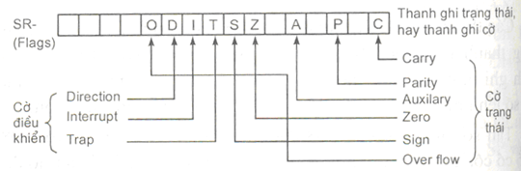
8086’s FR

Slide 12
Stack Pointer (SP)
Stack works under last in first out (LIFO) rule;
SP contains the address of the top of the stack;
Two operations:
Push:
SP ← SP + 1
{SP} ← Data
Pop:
Register ← {SP}
SP ← SP - 1
SP
Stack

Slide 13
General Purpose Registers
General Purpose Registers are registers used for multi purposes:
Examples: CPU Intel 8086 has four general purpose registers:
AX: Accumulator register
BX: Base register
CX: Counter register
DX: Data register

Slide 14
Instruction Register
Instruction register (IR) store op-code being executed;
IR loads an op-code from MBR and pass it to CU for decoding and executing.
MBR
IR
CU

Slide 15
MAR and MBR
MAR – (Memory address register):
Interface between CPU and bus A
Receive cell memory address from PC and pass it to bus A.
MBR –(Memory buffer register):
Interface between CPU and bus D
Receive op-code from bus D and pass it to IR through internal bus in CPU.

Slide 16
Temporary Registers
Temporary registers can be used for:
Storing input operants
Storing output results
Concurrent execution
Out Of Order execution (OOO)

Slide 17
Control Unit
Internal control signal
External control signal
Control Unit CU
ALU Flags
CLK
IR

Slide 18
Control Unit
Control Unit controlizes operations of CPU using CPU clock cycles;
CU’s inputs:
Op-code stored in IR
FR
Clock cycles
CU’s outputs:
Controlizes units inside CPU;
Controlizes units outside CPU
CU generizes clock cycles for synchronizing units inside and outside CPU.

Slide 19
Arithmetic Logic Unit (ALU)
IN
IN
ADD
SUB
NEG
SHL
MUL
DIV
SHR
ROL
NOT
OR
AND
ROR
XOR
OUT

Slide 20
ALU
ALU (Arithmetic and Logic Unit) comprises of computing sub-units:
ADD, SUB, MUL, DIV
SHIFT, ROTATE
NOT, AND, OR, XOR
ALU has
Two inputs (registers);
One output: to transfer computation results to registers.

Slide 21
Internal Bus
A channel for communicating among units inside of CPU (CU – Registers – ALU);
full duplex
Interfacing between internal and system bus;
Has high-speed broadband (much more than system bus).

Slide 22
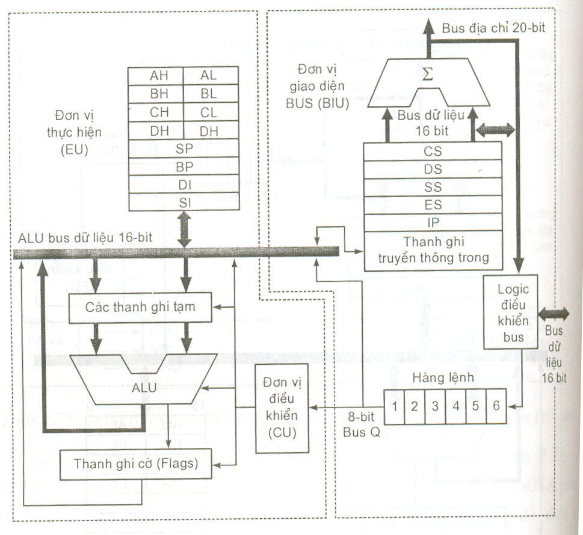
Intel 8086

Slide 23
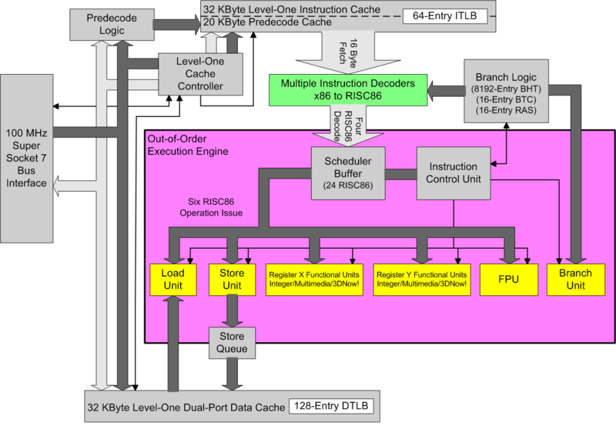
AMD K62

Slide 24
AMD K62

Slide 25
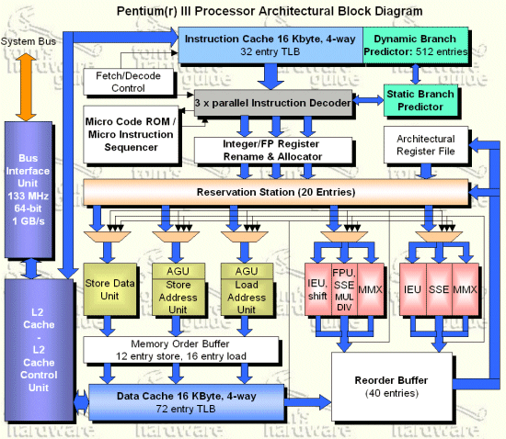
Intel Pen III

Slide 26
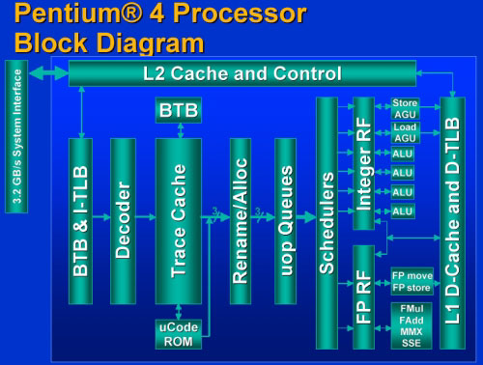
Intel Pen IV

Slide 27
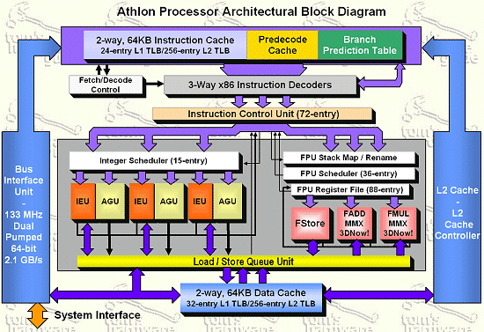
AMD Athlon XP

Slide 28
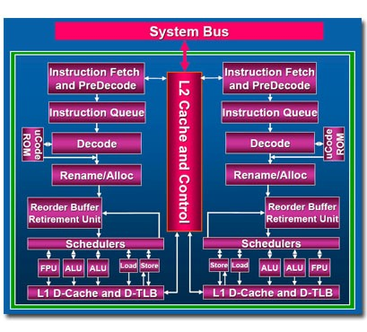
Intel Core 2 Duo

Slide 29
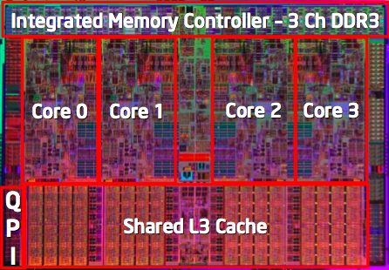
Nehalem used in Intel Core i5/i7 (2008)

Slide 30
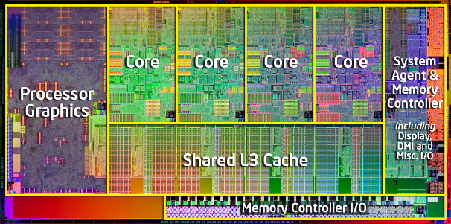
Sandy Bridge used in Intel Core i5/i7 (2010)

Slide 31

Introduction to pipeline

Slide 32

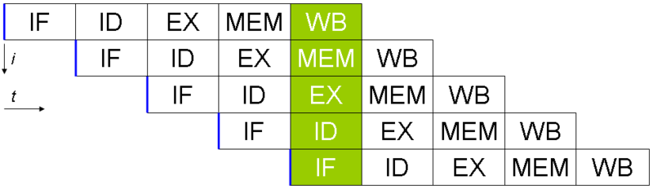
CPU pipeline
No pipeline
pipeline

Slide 33
CPU pipeline
An instruction is executed within 5 steps
5 steps:
Instruction Fetch - IF
Instruction Decode - ID
Execute - EX
Memory Access - MEM:
Write Back - WB:

Slide 34
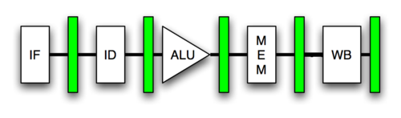
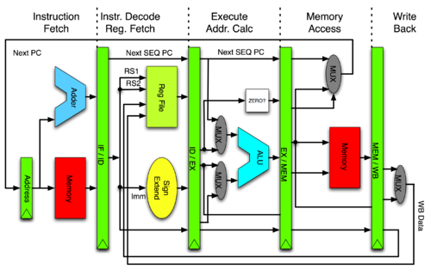
CPU pipeline’s hardware

Slide 35
Pipeline hazards
Resource conflicts
Memory access
Register access
Data hazards
Branch instructions
Unconditional jumps
Conditional jumps
Call and return

Slide 36
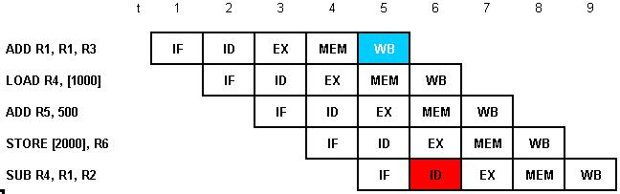
Data hazards and solutions

Slide 37
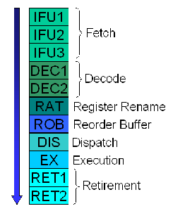
Pipeline example – P6 (PIII, M)

Slide 38
Resource hazards
insufficient computing resource;
If memory allows one access at one time, but there are two or more accesses, pipeline requests two memory accesses (i.e. IF and ID) → memory hazard.

Slide 39
Branch hazards
Branch dominates about 10-30% of instructions. Branch can cause the following issues:
Interruption of program execution;
Make the pipeline be emptied.
The more pipeline stages, the more complicated is (i.e. more paralleled instruction executions) :
The pipeline bubbles need to be filled out;
Branch prediction.

Slide 40
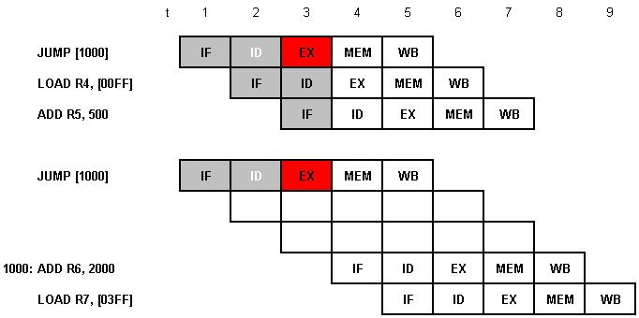
Branch hazard example

Slide 41
Branch hazard example
Code example:
ADD R2, R3, R4
CMP R1,0
JNE somewhere
Insert NO-OP right below the branch
ADD R2, R3, R4
CMP R1,0
JNE somewhere
NO-OP
Move the independent instructions to right before the branch:
CMP R1,0
JNE somewhere
ADD R2, R3, R4

